Slide 1
K Nearest Neighbors

Slide 2
Reading Assignment
Chapter 4 of the Introduction to Statistical Learning By Gareth James, et all

Slide 3
KNN
K Nearest Neighbors is a classification algorithm that operates on a very simple principle.
It is best shown through example!
Imagine we had some imaginary data on Dogs and Horses, with heights and weights.

Slide 4
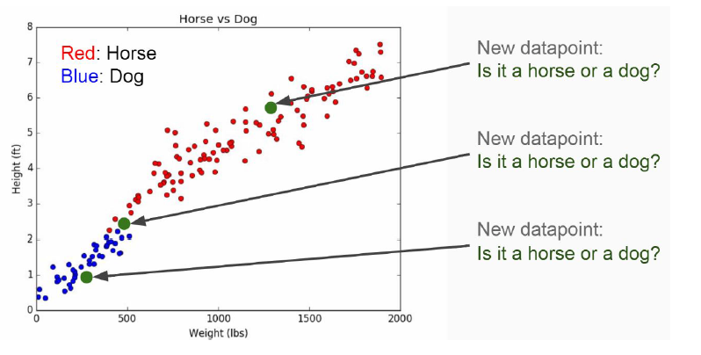
KNN

Slide 5
How to do it?
Choose the number k of neighbors
Step 2: Take k nearest neighbors of the new data point, according to the Euclidean distance
Step 3: Among the k neighbors, count the number of data points in each category
Step 4: Assign the new data point to the category where you counted the most neighbors
Your model is Ready

Slide 6
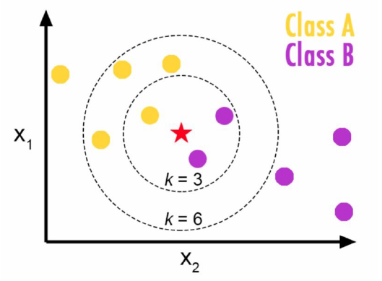
KNN
Choosing a K will affect what class a new point is assigned to:

Slide 7
KNN Model
Training Algorithm:
Store all the data
Prediction Algorithm:
Calculate the distance from x to all points in your data
Sort the points in your data by increasing distance from x
Predict the majority label of the “k” closest points

Slide 8
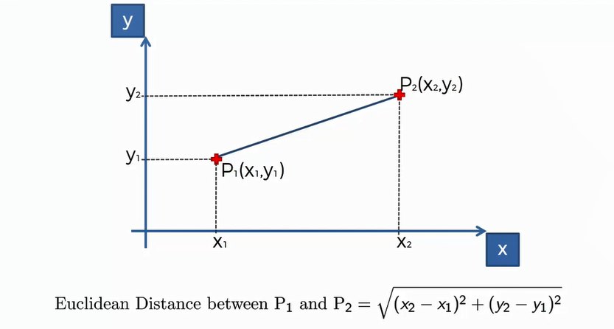
Euclidean Distance

Slide 9
Pros:
Very simple
Training is trivial
Works with any number of classes
Easy to add more data
Few parameters
K
Distance Metric

Slide 10
Cons:
High Prediction Cost (worse for large data sets)
Not good with high dimensional data
Categorical Features don’t work well

Slide 11
Let’s get into action with python, see you in next lecture!

